Slide 2

Semester Project of Test Automation (LeetCode) By
Devmalya Bandyopadhyay Abhishek Sharma
500069119 500067644
R171218039 R171218005
Under the guidance of
Ms. Nitika Goenka,
Assistant Professor,
School of computer science.

Slide 3
ABSTRACT
Software testing is one of the vital and crucial phase of software development lifecycle. Today many software applications are developed as web based application that runs directly through Internet browser. The importance of controlling and improving the quality of web applications will increase its economic relevance. Automation testing decreases the test cost and increases work efficiency to deliver a high quality and stable product at the end. Web applications are flattering additional complexity that applications are difficult to test manually. It will increase the time and cost. Accurate results can't be provided. This can be avoided by using test automation. The objective of the paper is to make test automation intended for Web applications using Software testing tool, Selenium. It is a collection of testing tool running with multiple browsers, operating systems and many programming languages. Selenium contains almost all the characteristics to automate tests and it is used to build test cases for web applications.

Slide 4
LeetCode
LeetCode is one of the most well-known online judge platforms that you can use to practice your programming skills by solving coding questions. It has over 1,100 different problems, support for over 18 programming languages, and an active community that is always there to help you with the solutions you come up with. If your intention is to hone your coding skills, then this online judge platform is one of the best that you can use.
Most of LeetCode’s content is free, but LeetCode Premium enhances all of its positives by granting you access to things like access to premium problems and solutions, access to a built-in debugger, an autocomplete function, and interview simulations with feedback. It also makes it even more effective if you’re using it to prepare for technical interviews, as it grants you access to company-specific programming questions that you can use to have a better grasp of what you can expect from the questions you’ll face in interviews with companies like Google, Facebook, and Microsoft, making it the ideal online judge to use if your sights are set on one of these FAANG companies.

Slide 5
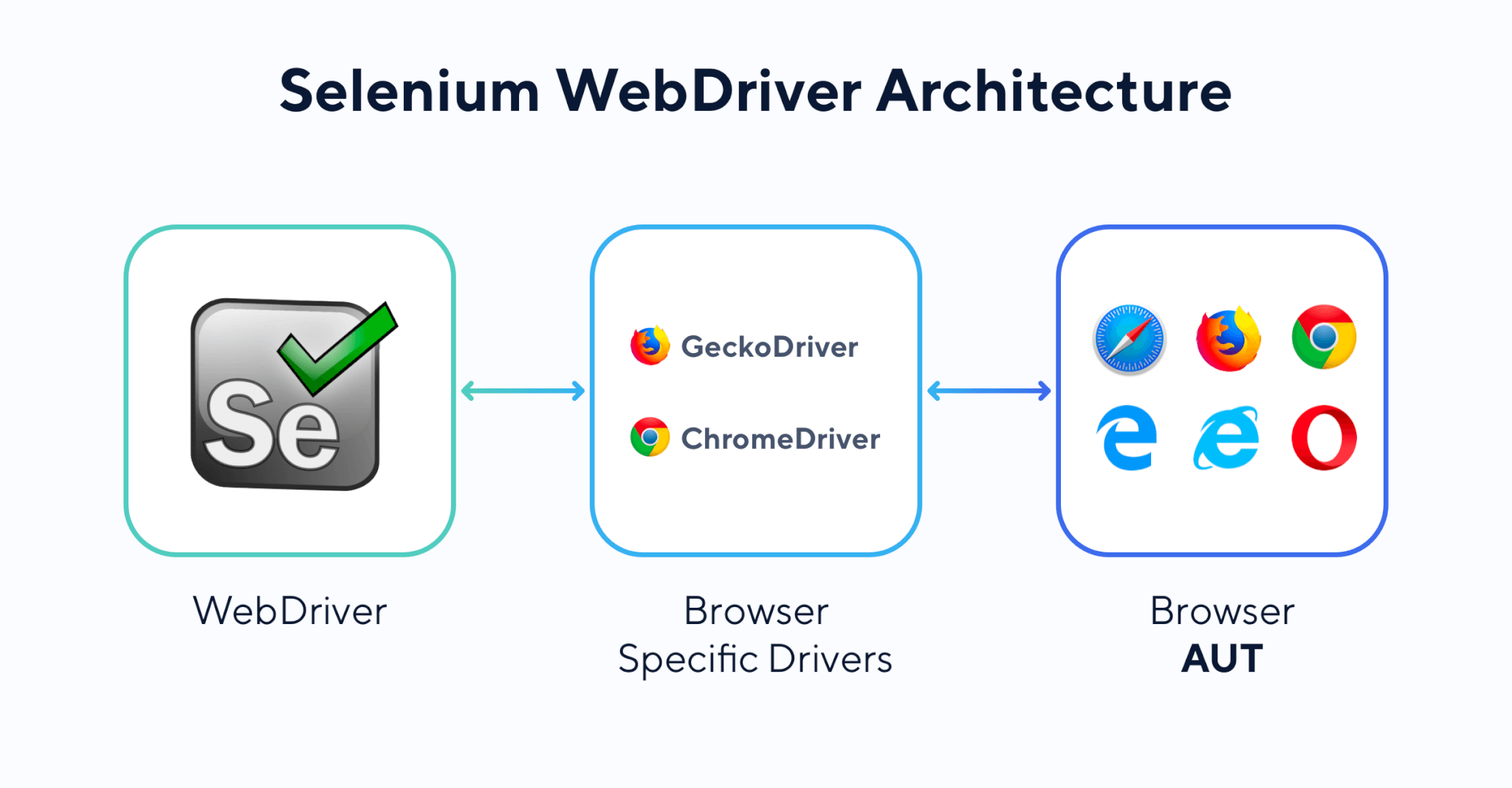
Selenium
Selenium is a portable framework for testing web applications. It provides a playback tool for authoring functional tests without the need to learn a test scripting language.

Slide 6
Testing we have done in LeetCode :-
SignUp(Using excel sheet)
LogIn (Using excel sheet)
Home Page of LeetCode
via run.bat file
via Jenkins

Slide 7
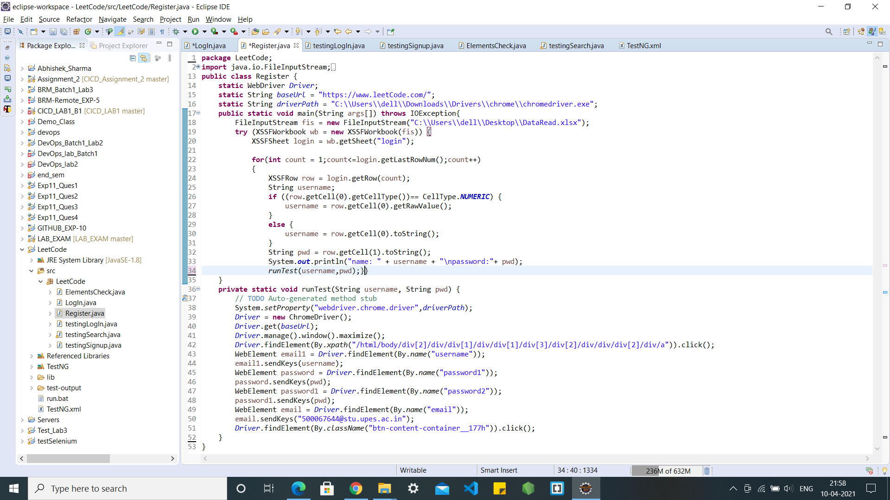
Sign up

Slide 8
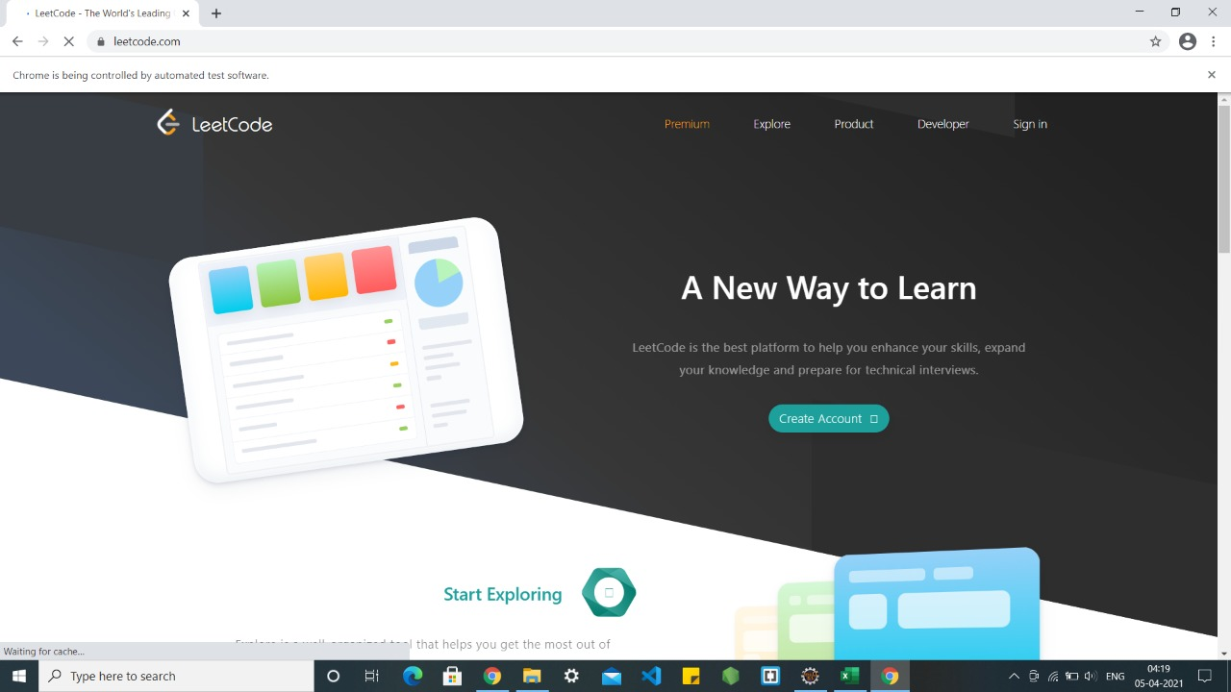
Testing Sign up

Slide 9
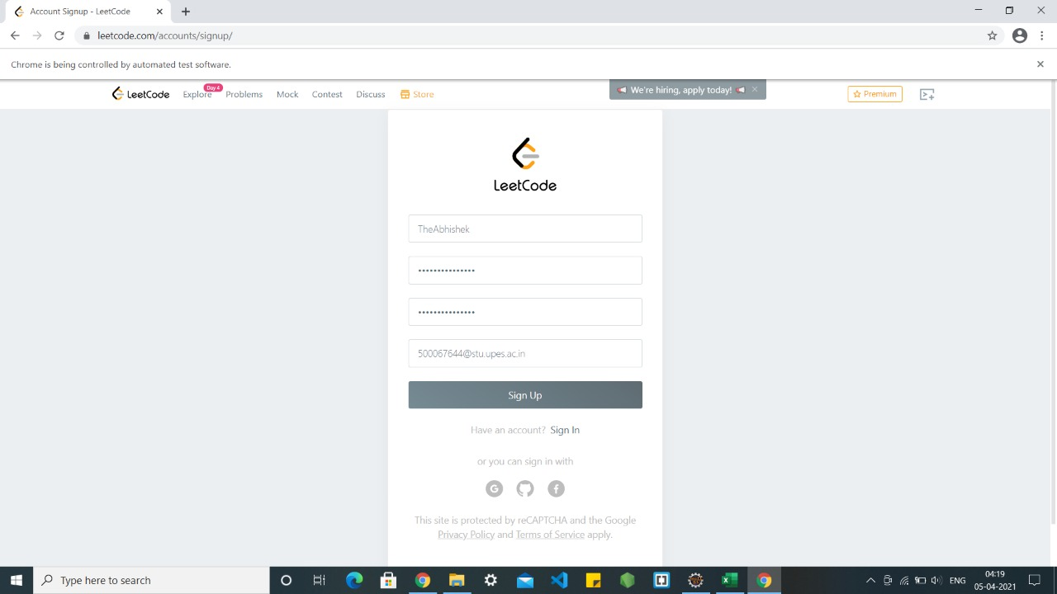
Testing Sign up

Slide 10
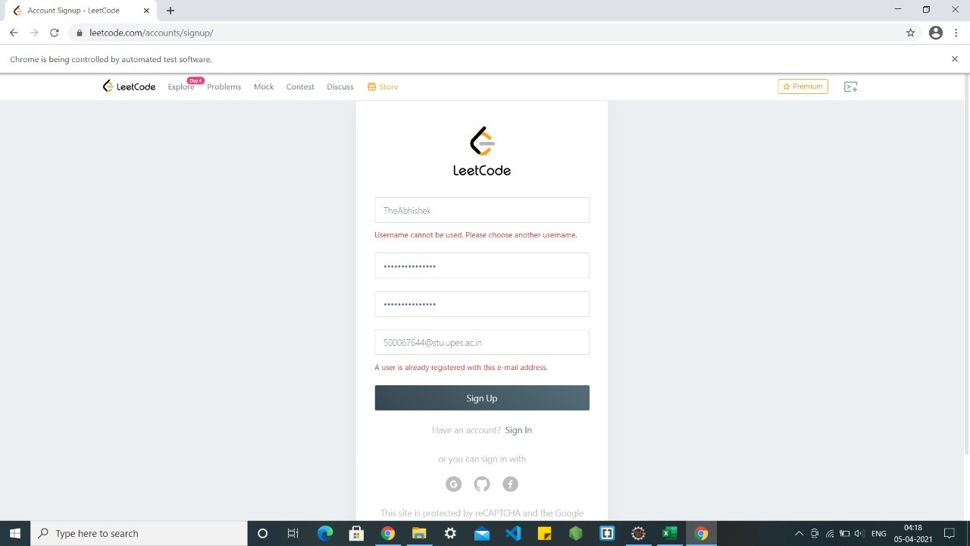
Testing Sign up

Slide 11
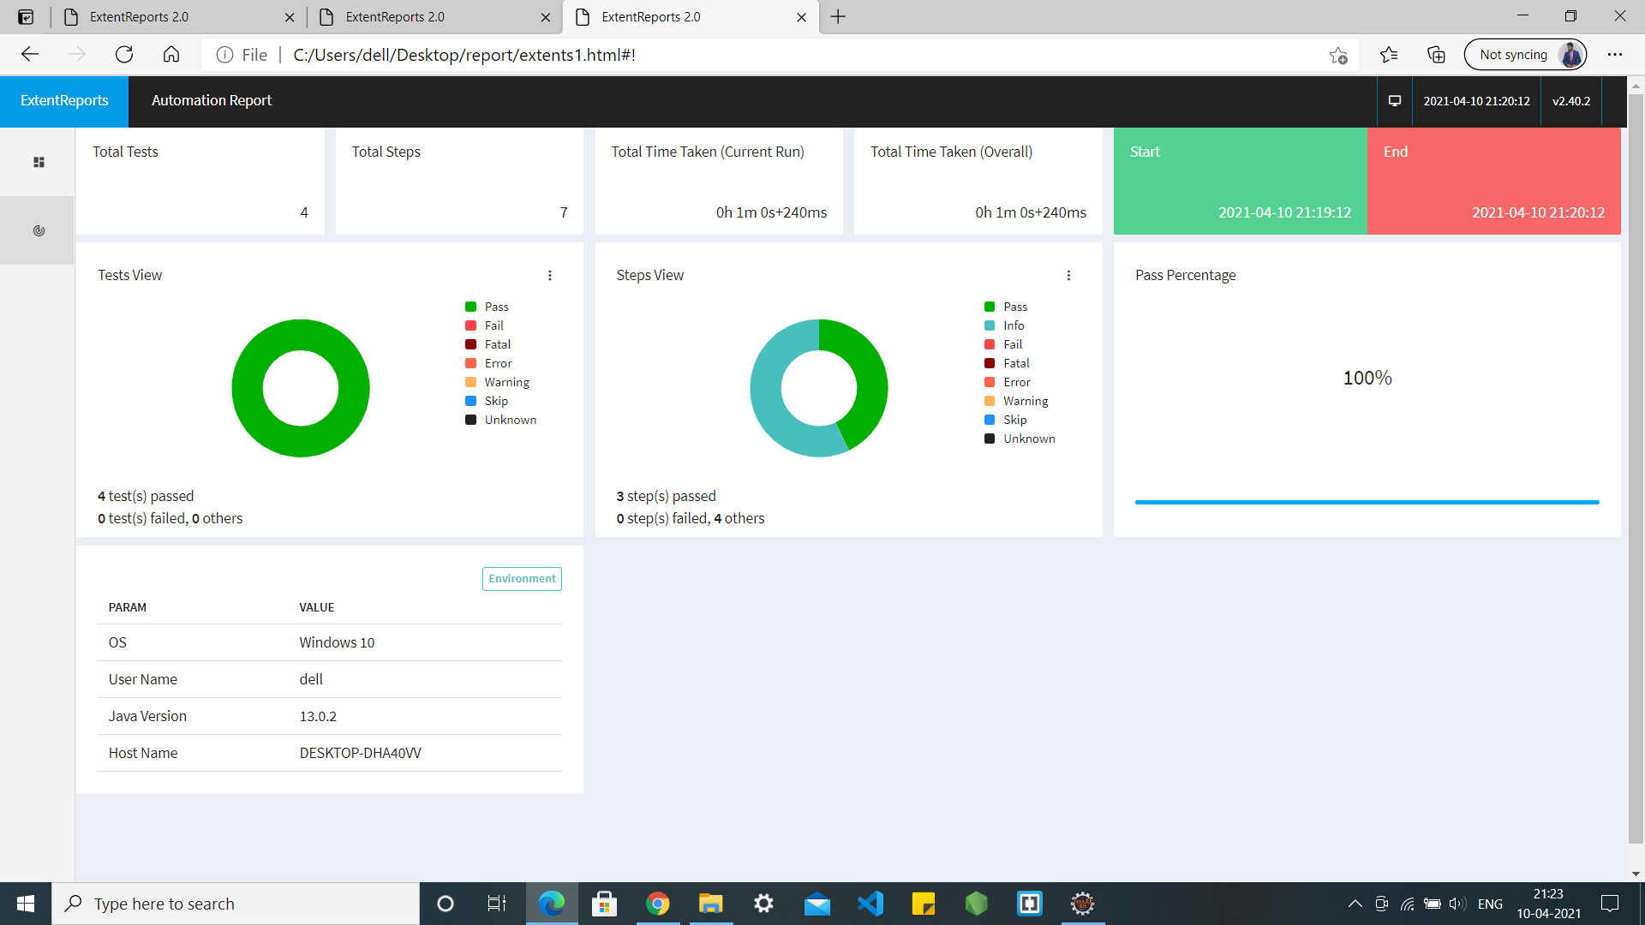
Sign up Testing

Slide 12
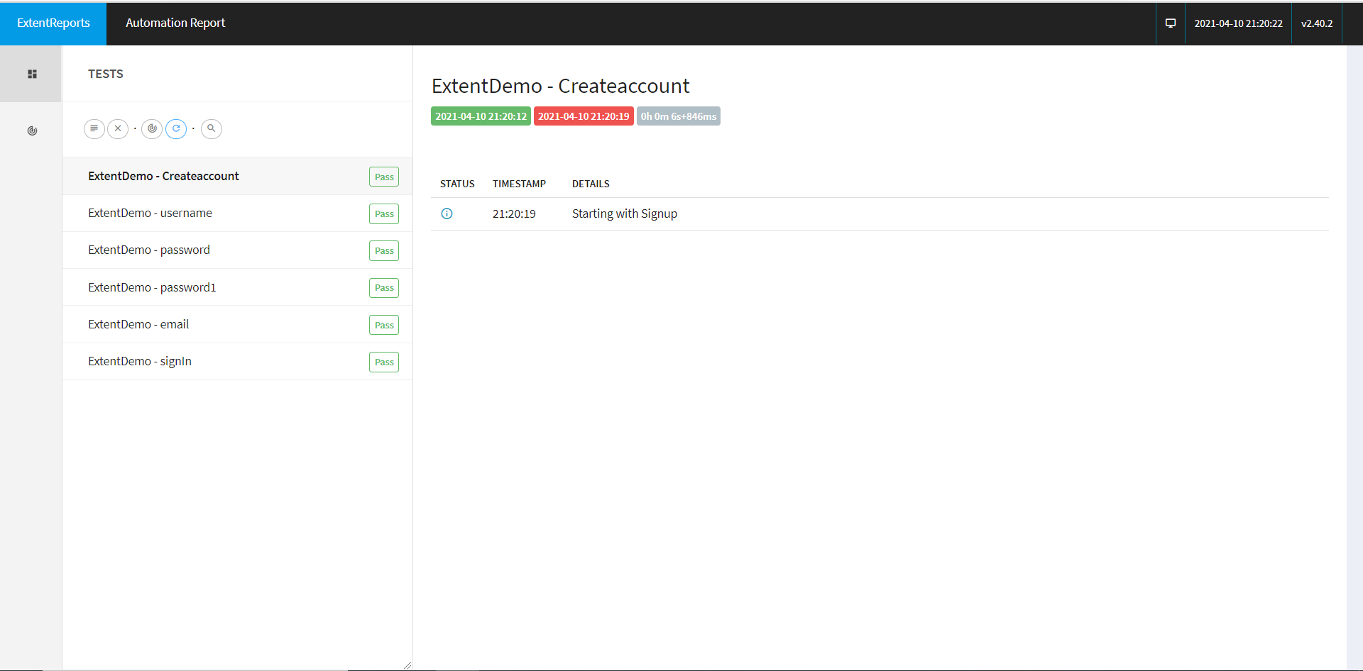
Sign up Testing

Slide 13
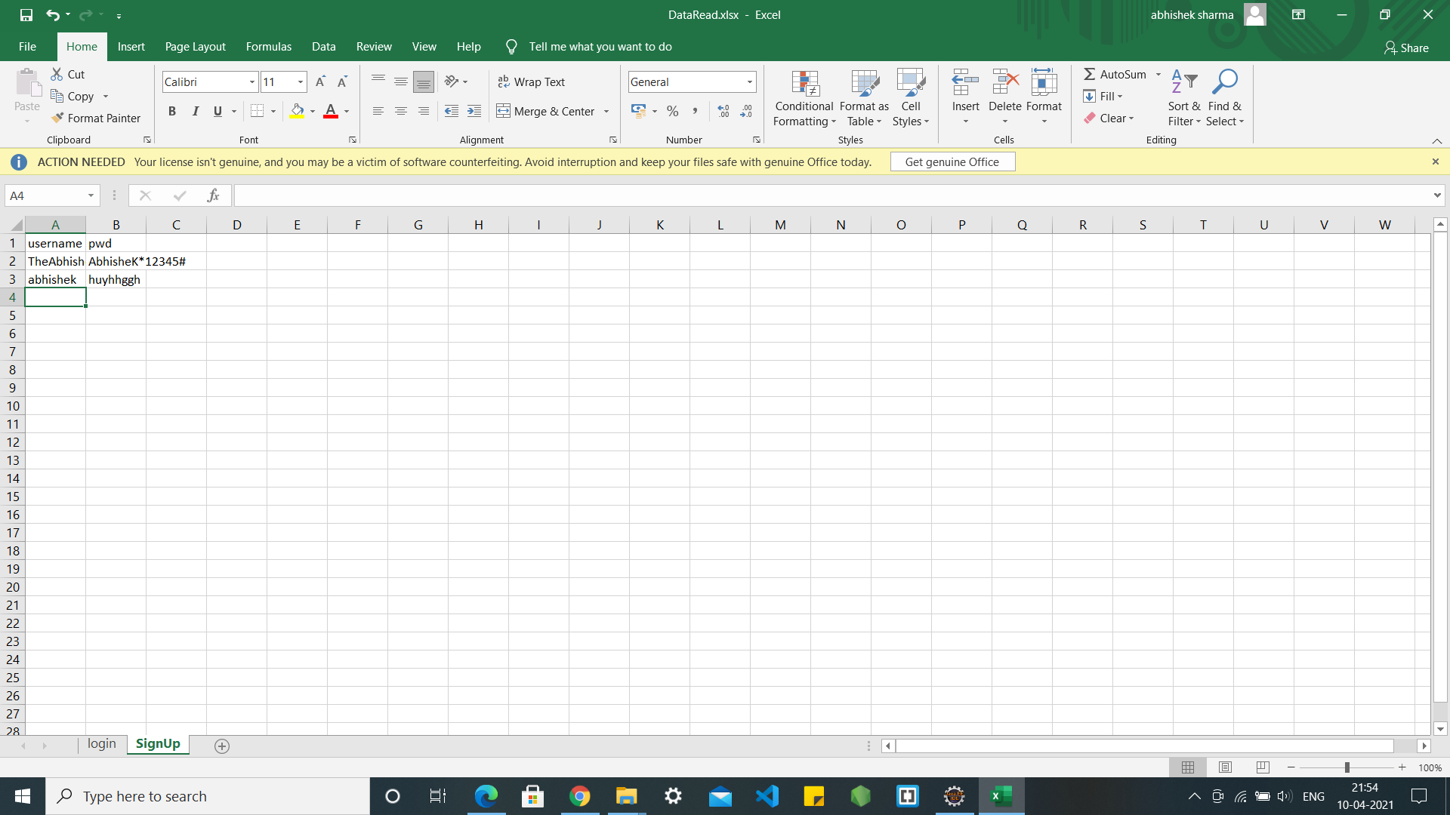
Testing Sign up via Excel Sheet

Slide 14
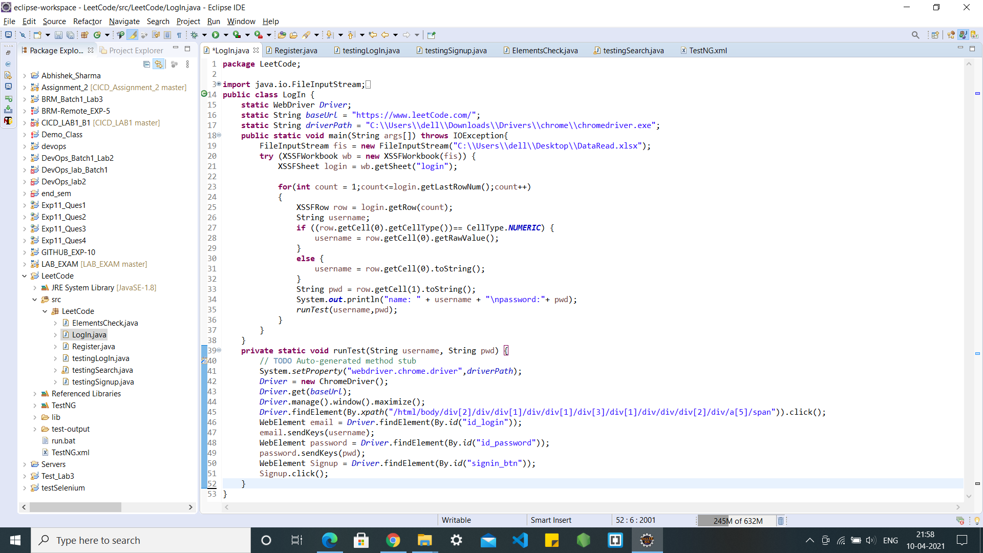
LOGIN

Slide 15
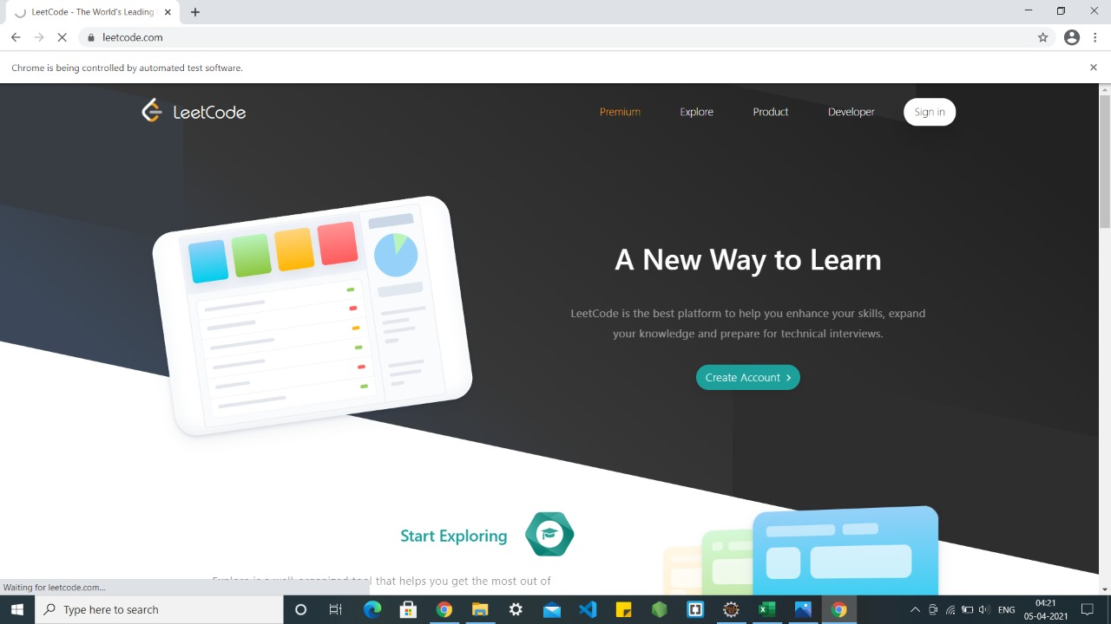
LOGIN TESTING

Slide 16
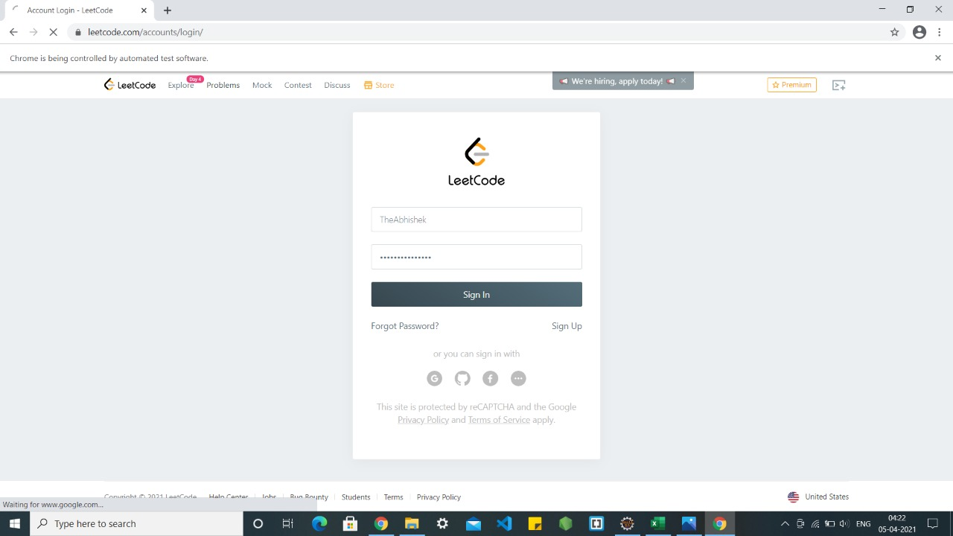
LOGIN TESTING

Slide 17
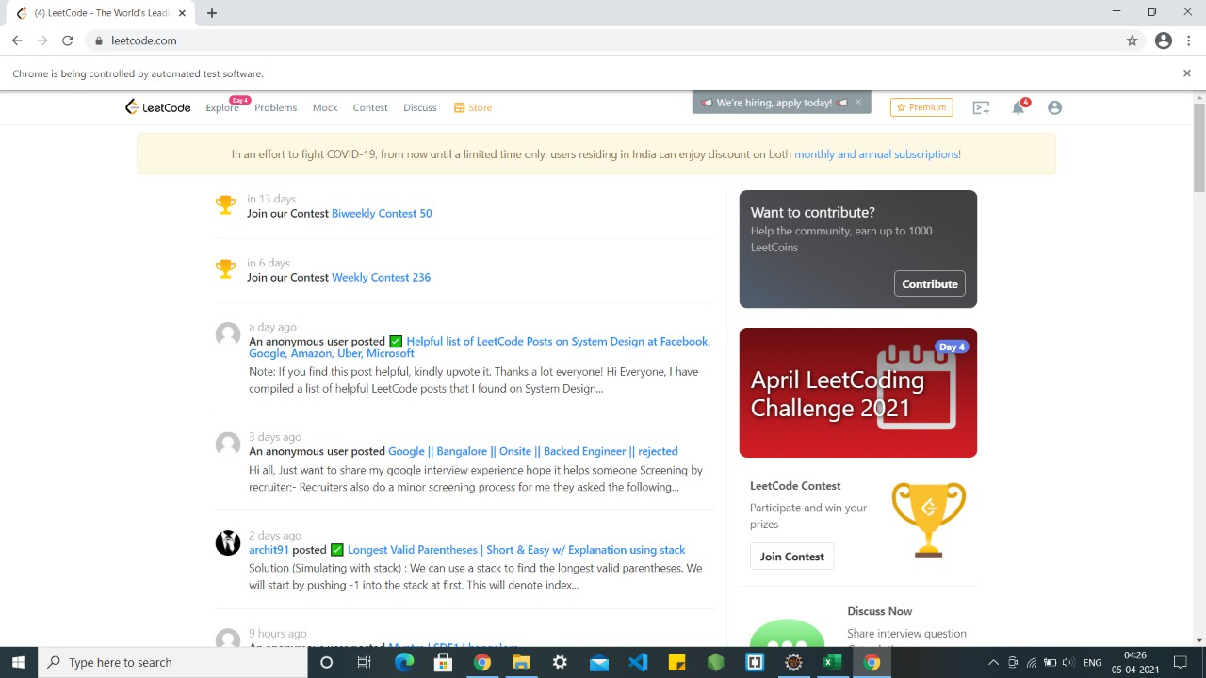
LOGIN TESTING

Slide 18
Login Testing

Slide 19
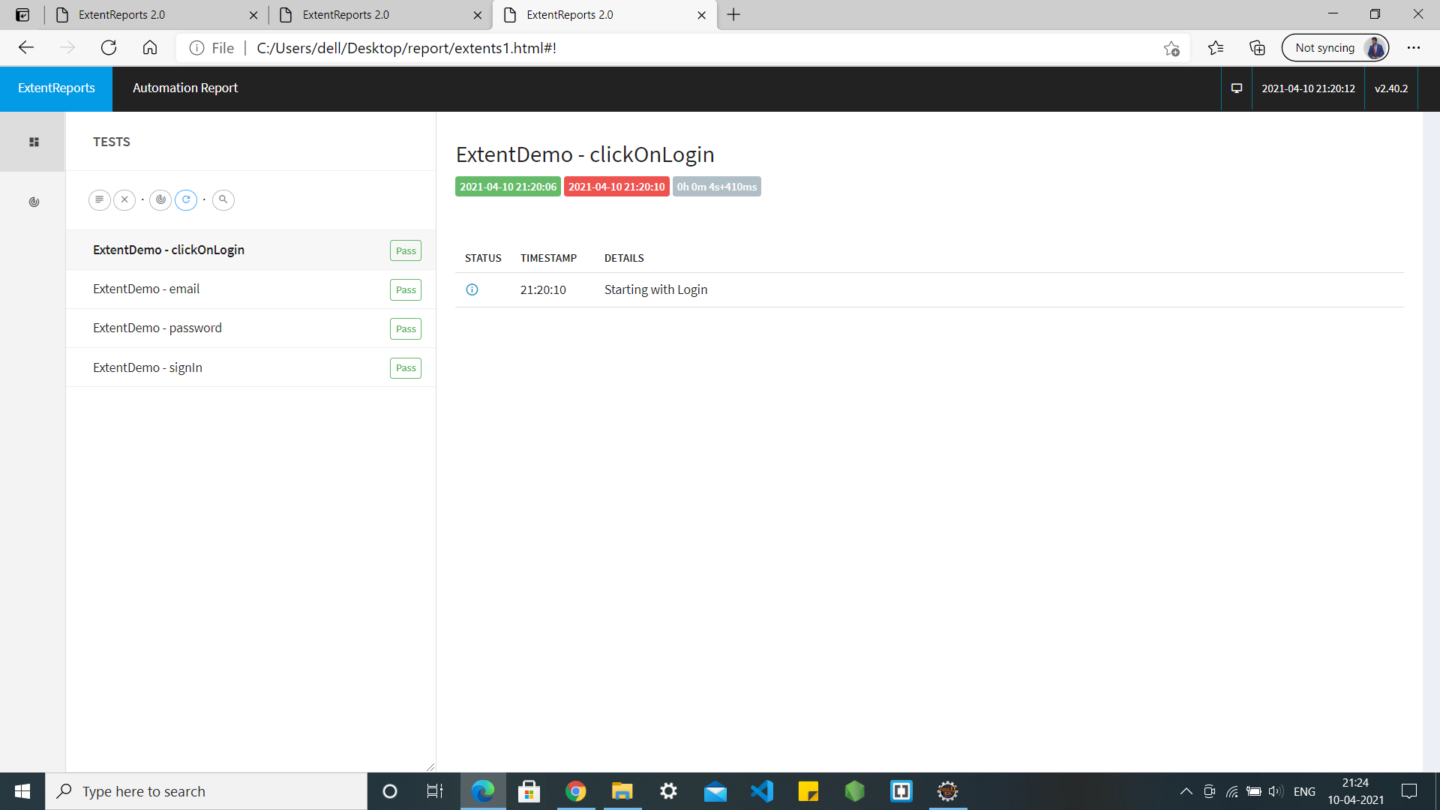
Login Testing

Slide 20

Testing Login via Excel Sheet

Slide 21
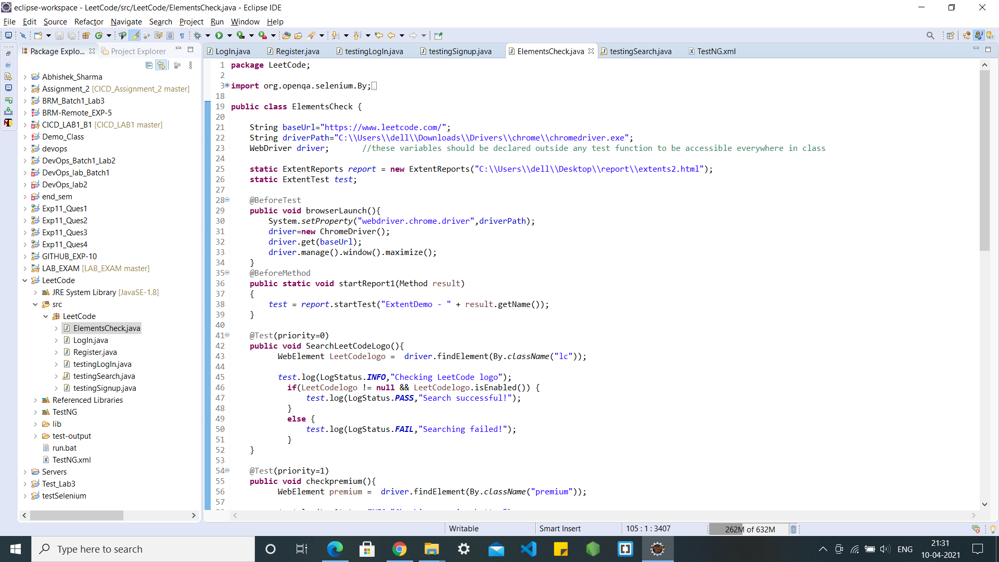
LeetCode Home Page

Slide 22
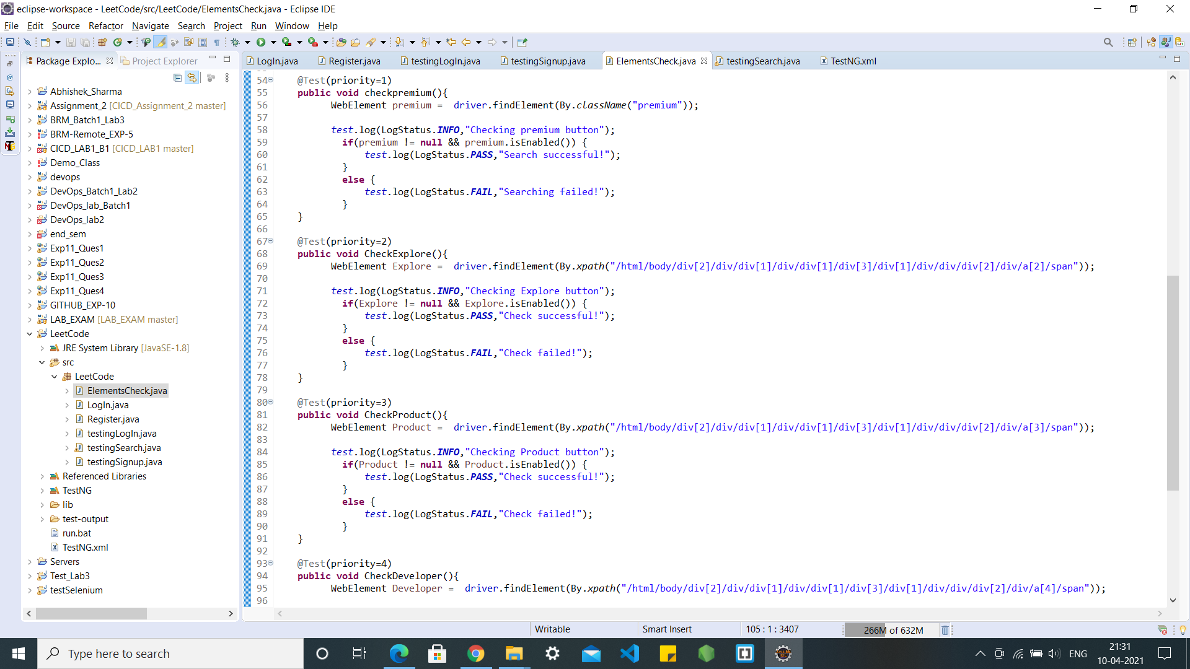
LeetCode Home Page

Slide 23
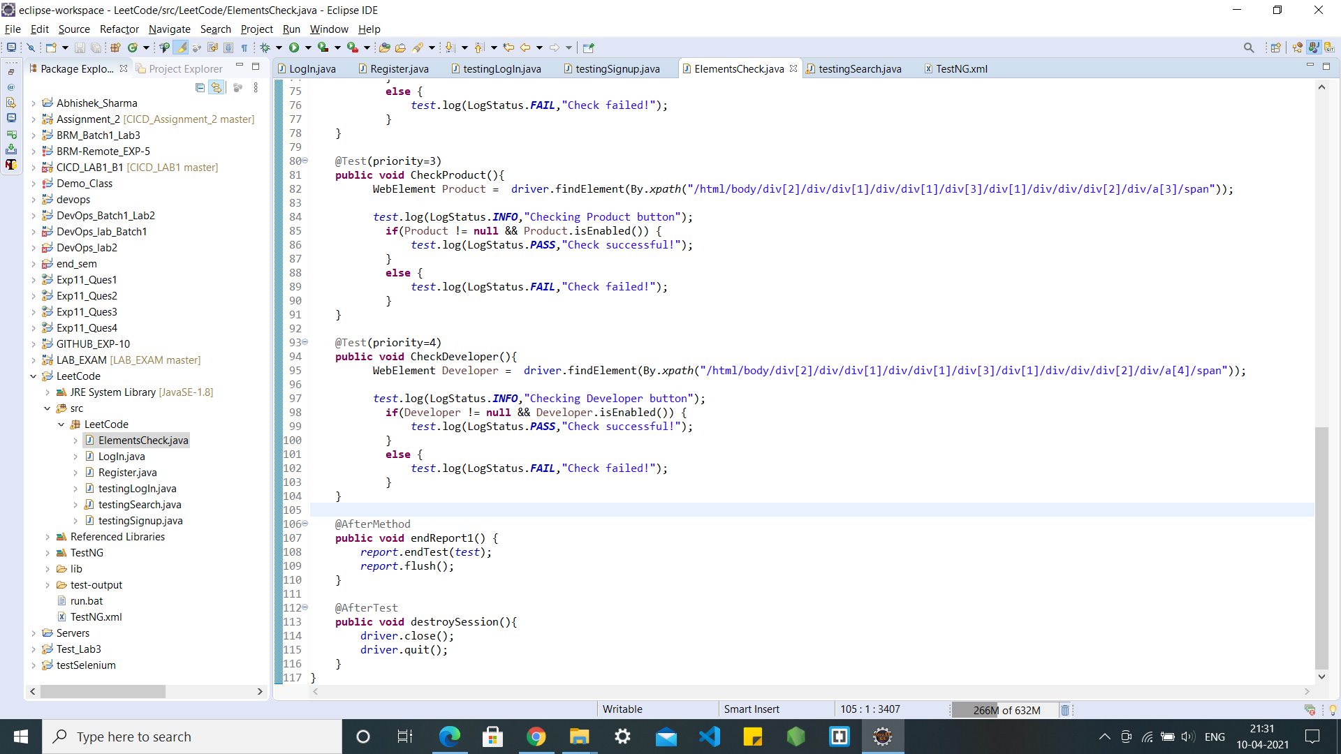
LeetCode Home Page

Slide 25
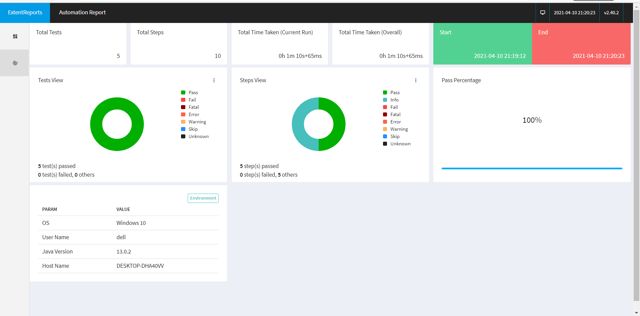
LeetCode Home Page

Slide 26
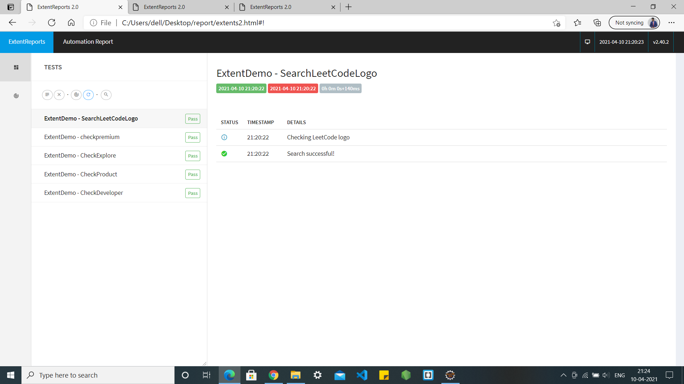
LeetCode Home Page

Slide 27
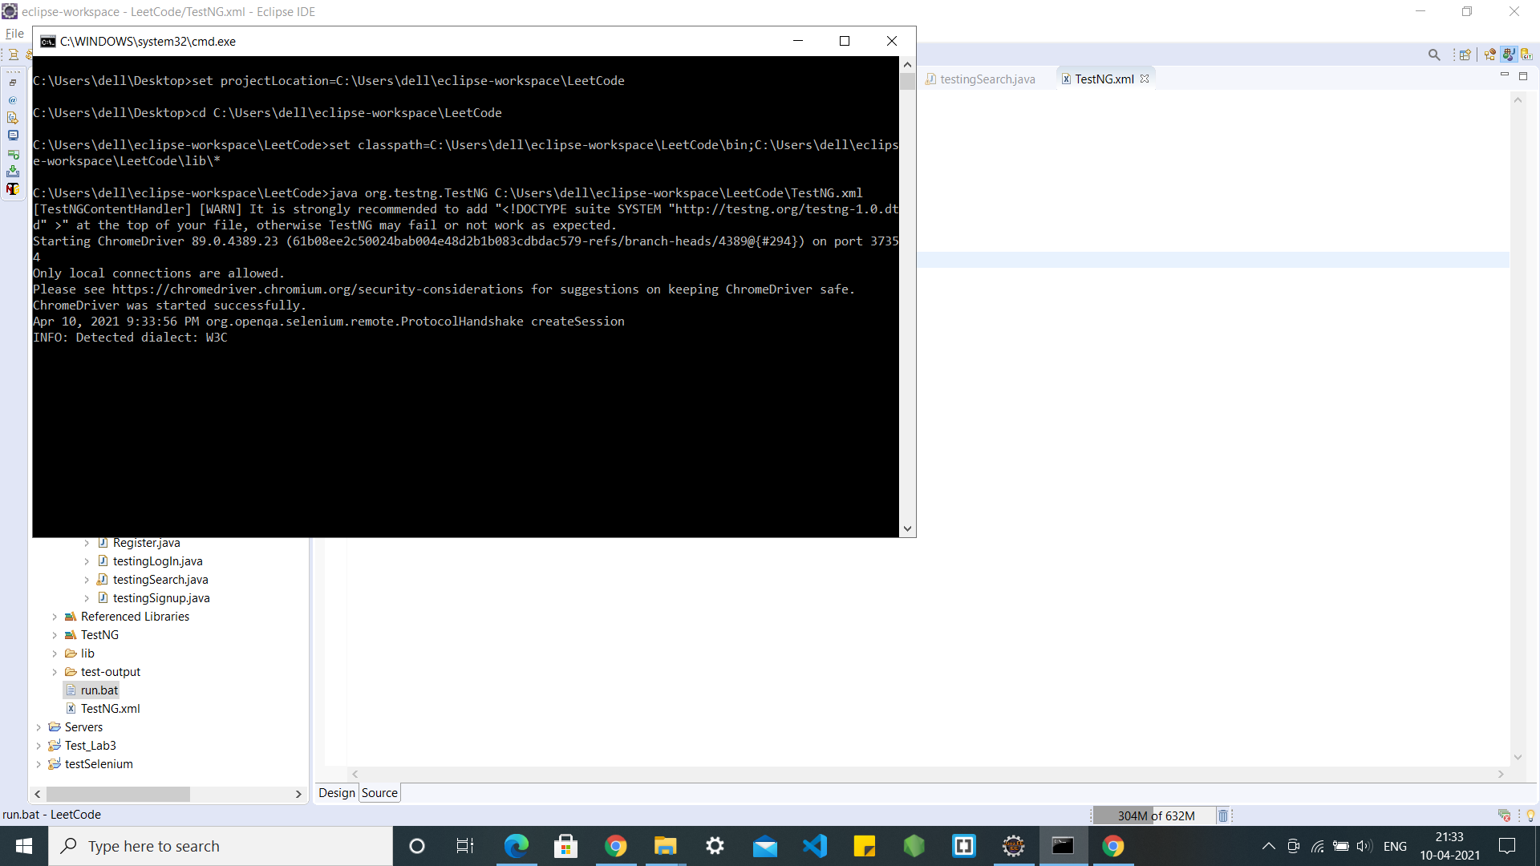
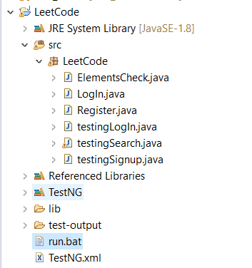
Test through run.bat file

Slide 28
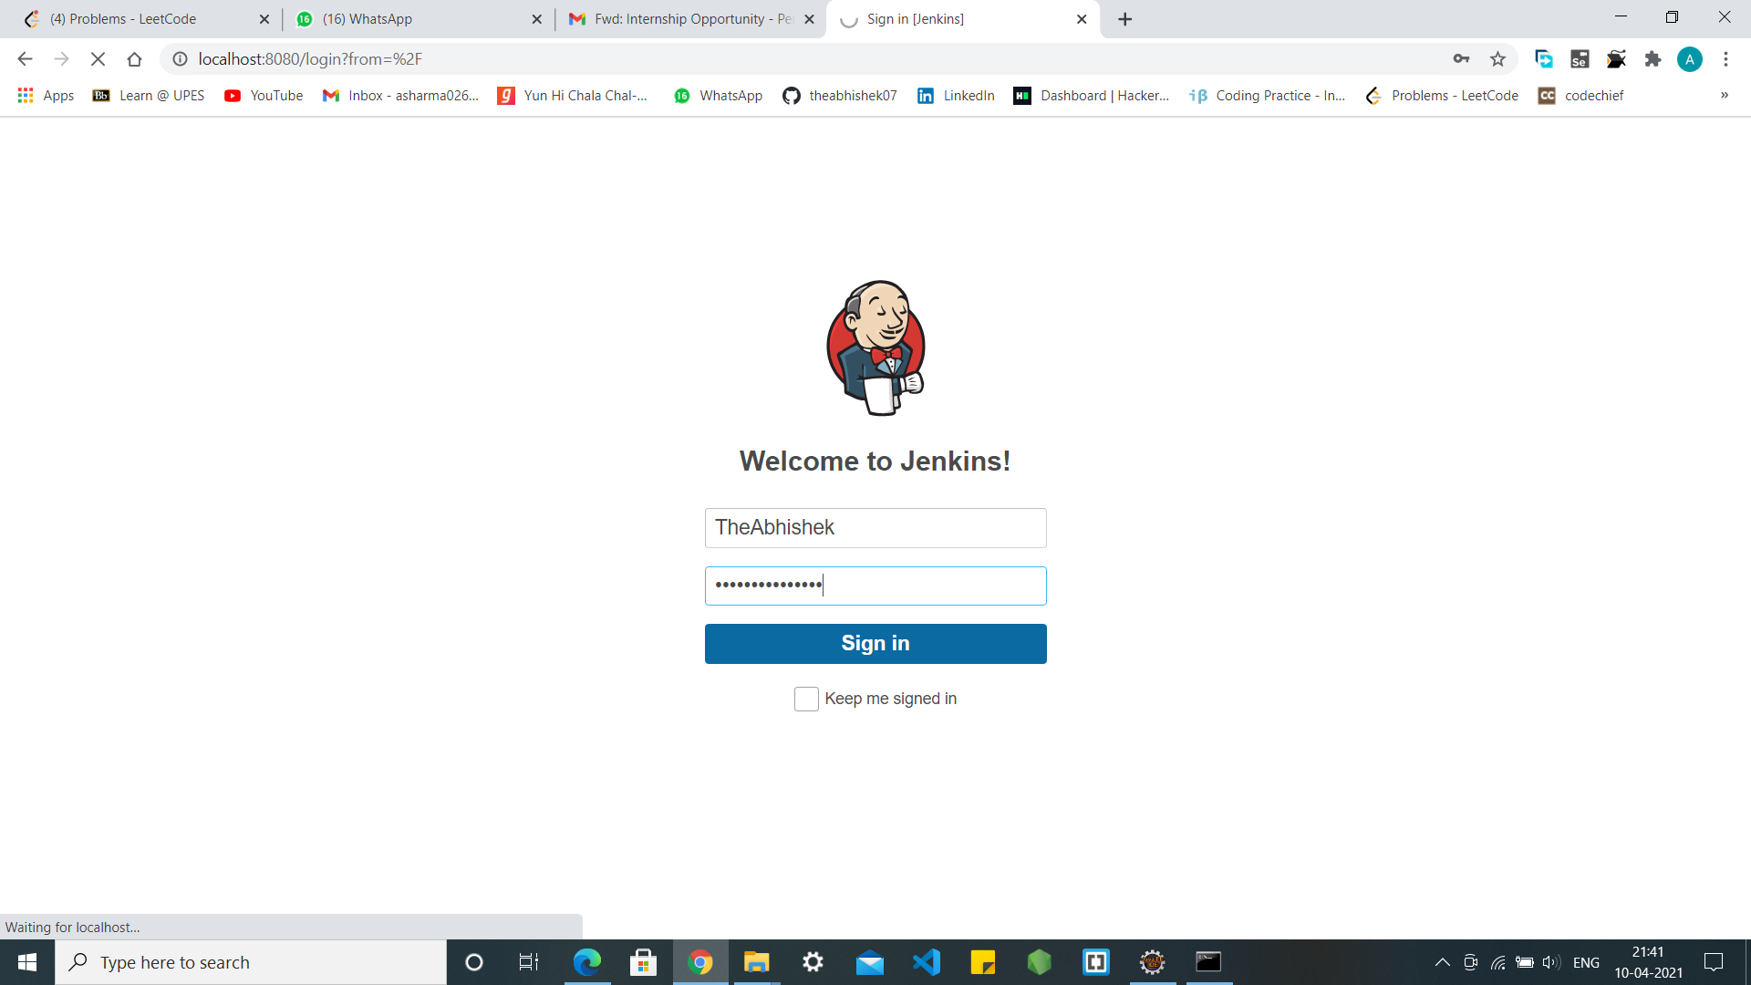
Jenkins

Slide 29
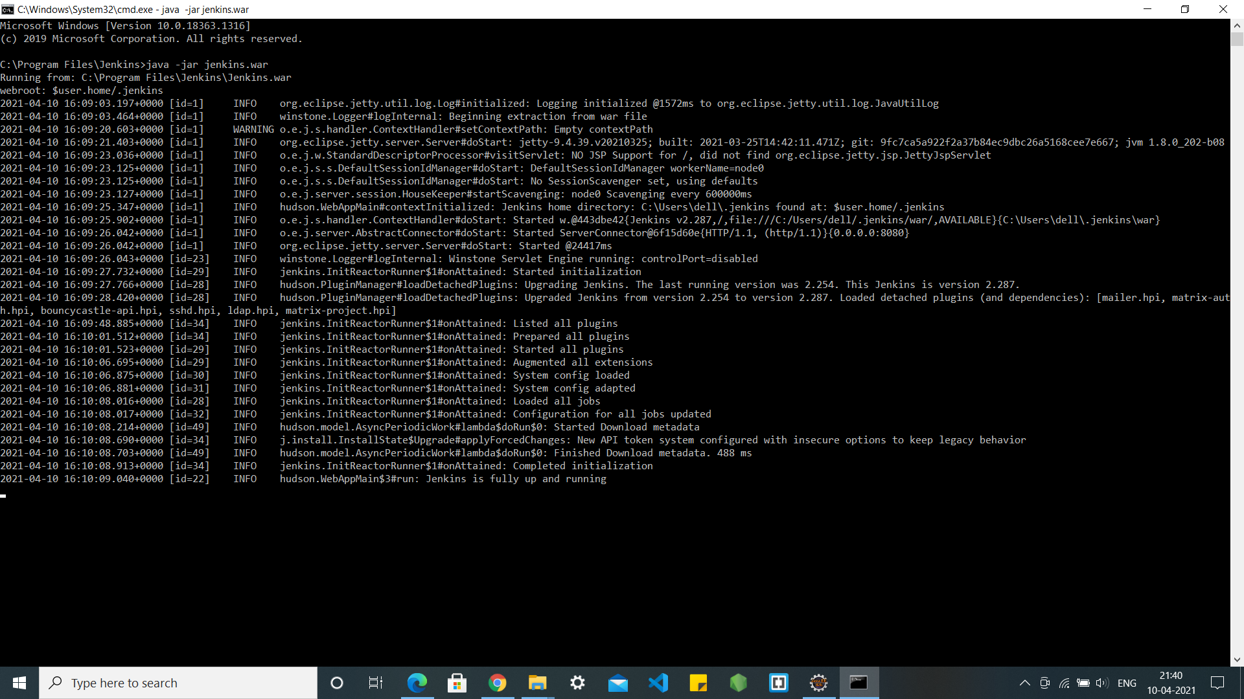
Jenkins

Slide 30
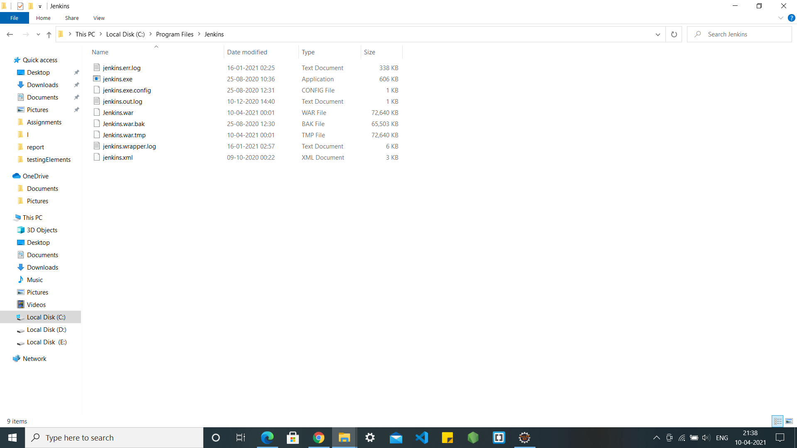
Jenkins files

Slide 31
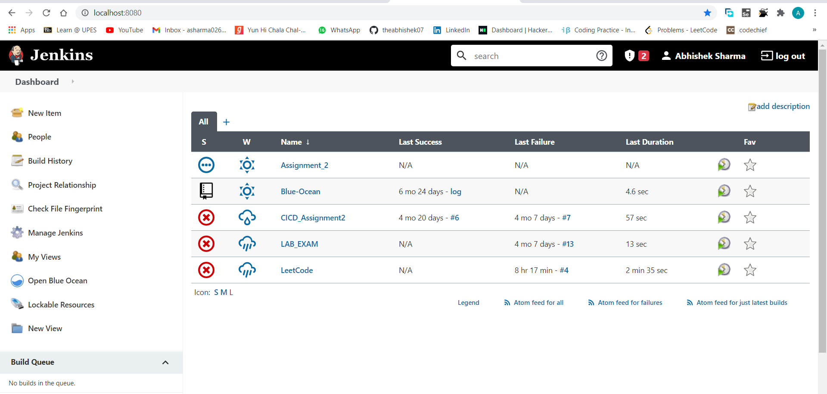
Testing via Jenkins

Slide 32
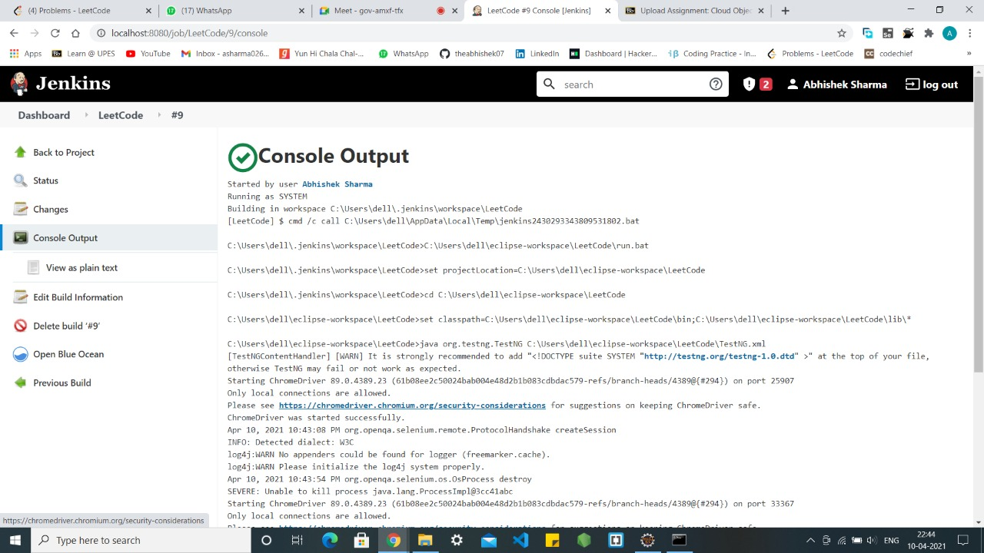
Testing via Jenkins

Slide 33
System Requirements
Hardware requirements:
8 - 32 GB RAM
20GB storage
2 - 4 GB Graphics memory
Software Memory:-
Eclipse
JDK
Internet

